Slide 1
Approximate Optimisation Algorithms using Quantum Relaxation
Charles Hadfield, Takashi Imamichi, Toshinari Itoko, Antonio Mezzacapo, Rudy Raymond
Quantum Applications Research, January, 2021

Slide 2
Building Aircraft Wings with Magic States
Charles Hadfield, Takashi Imamichi, Toshinari Itoko, Antonio Mezzacapo, Rudy Raymond
Quantum Applications Research, January, 2021

Slide 3
Outline of today’s presentation
Motivation
Bells and whistles
Cogs in the machine
Numerics
Big picture

Slide 4
Motivation
Combinatorics
Quantum mechanics

Slide 5
Results
We consider MaxCut and for a given graph we:
propose to solve the problem on a quantum computer using qubits
embed binary-variable strings into quantum states using quantum random access codes
build a 2-local Hamiltonian whose energy evaluates the cut function
propose to solve the relaxed Hamiltonian eigenvalue problem using any near-term algorithm
round the relaxed solution to an admissible solution using magic bases
obtain a lower bound for the approximation ratio in the spirit of Goemans-Williamson

Slide 6
MaxCut with Magic
Charles Hadfield, Takashi Imamichi, Toshinari Itoko, Antonio Mezzacapo, Rudy Raymond

Slide 7
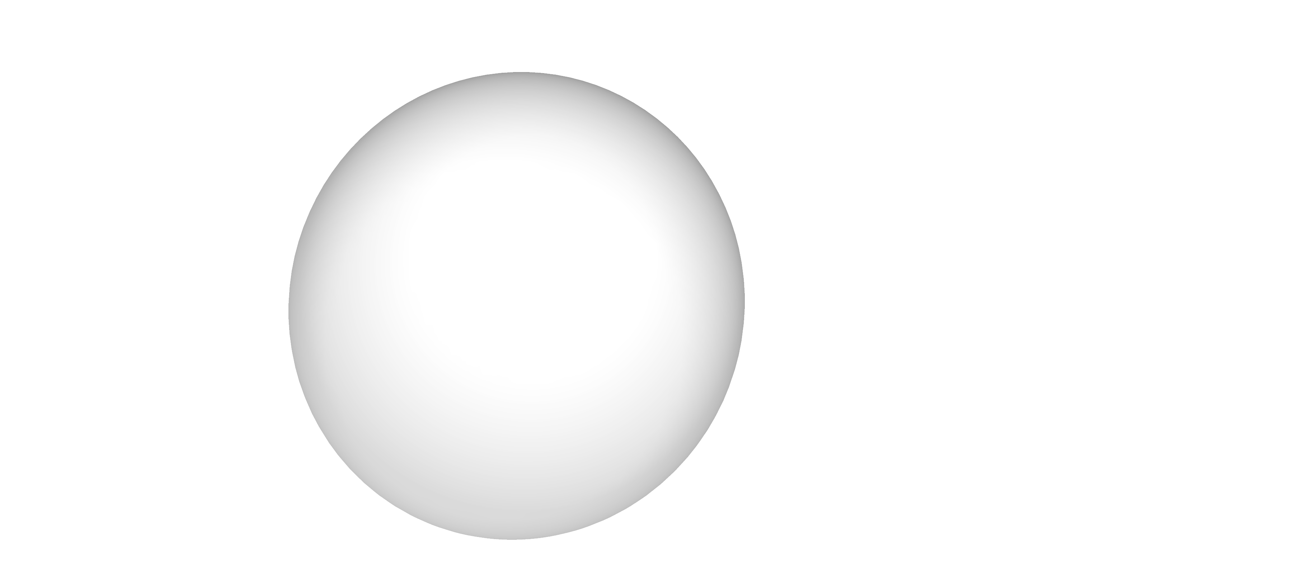
Quantum random access codes

Slide 8
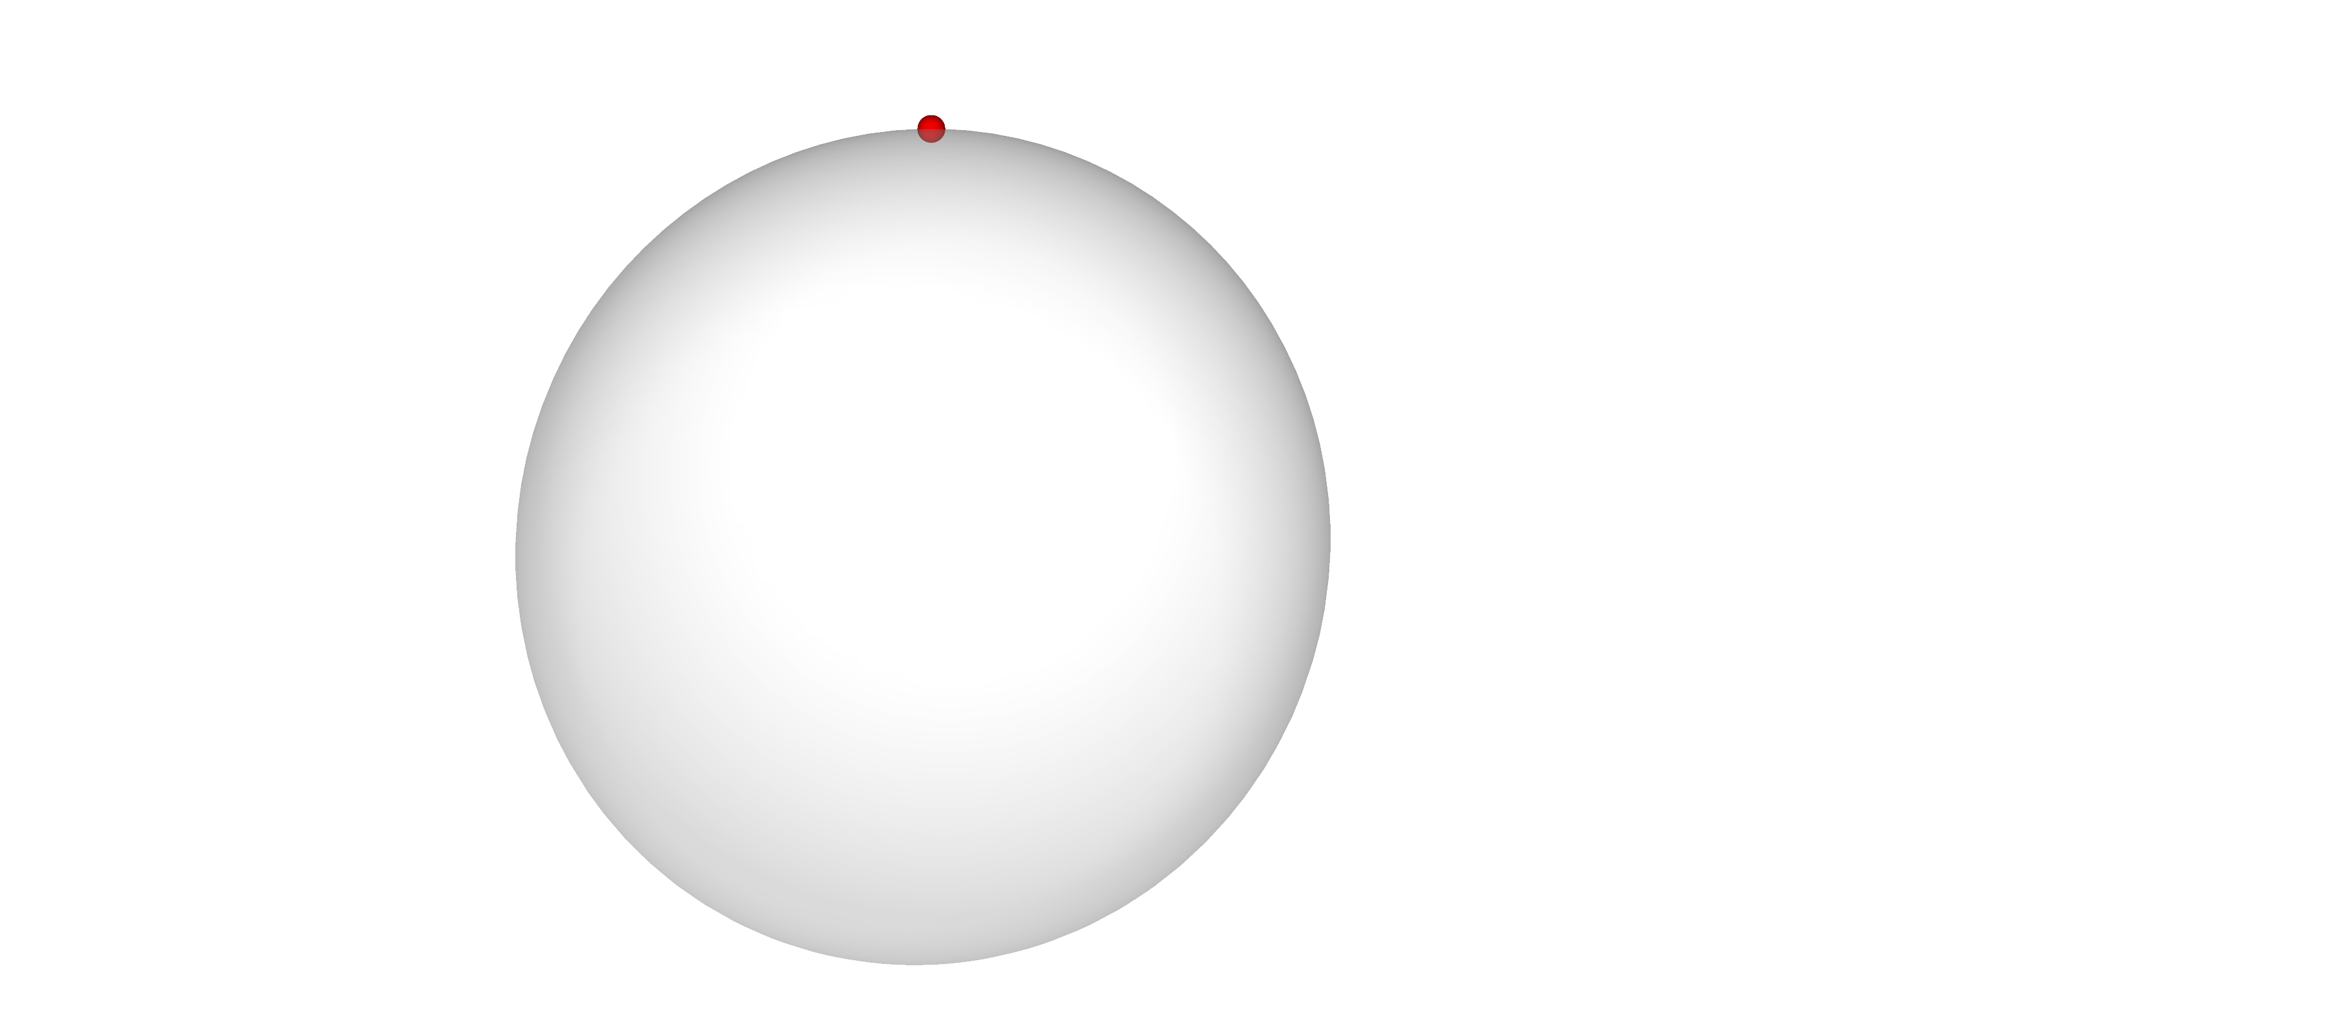
Quantum random access codes

Slide 9
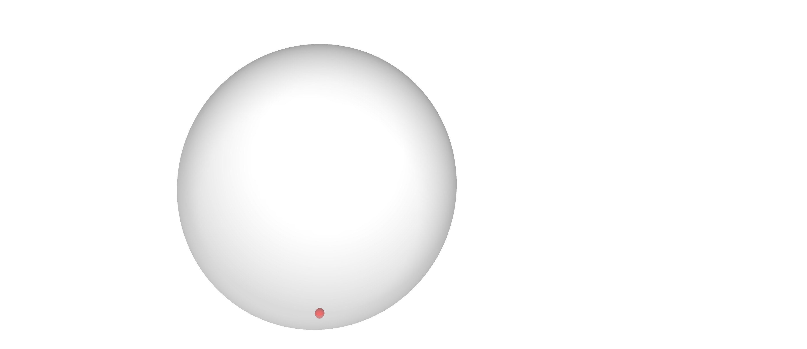
Quantum random access codes

Slide 10
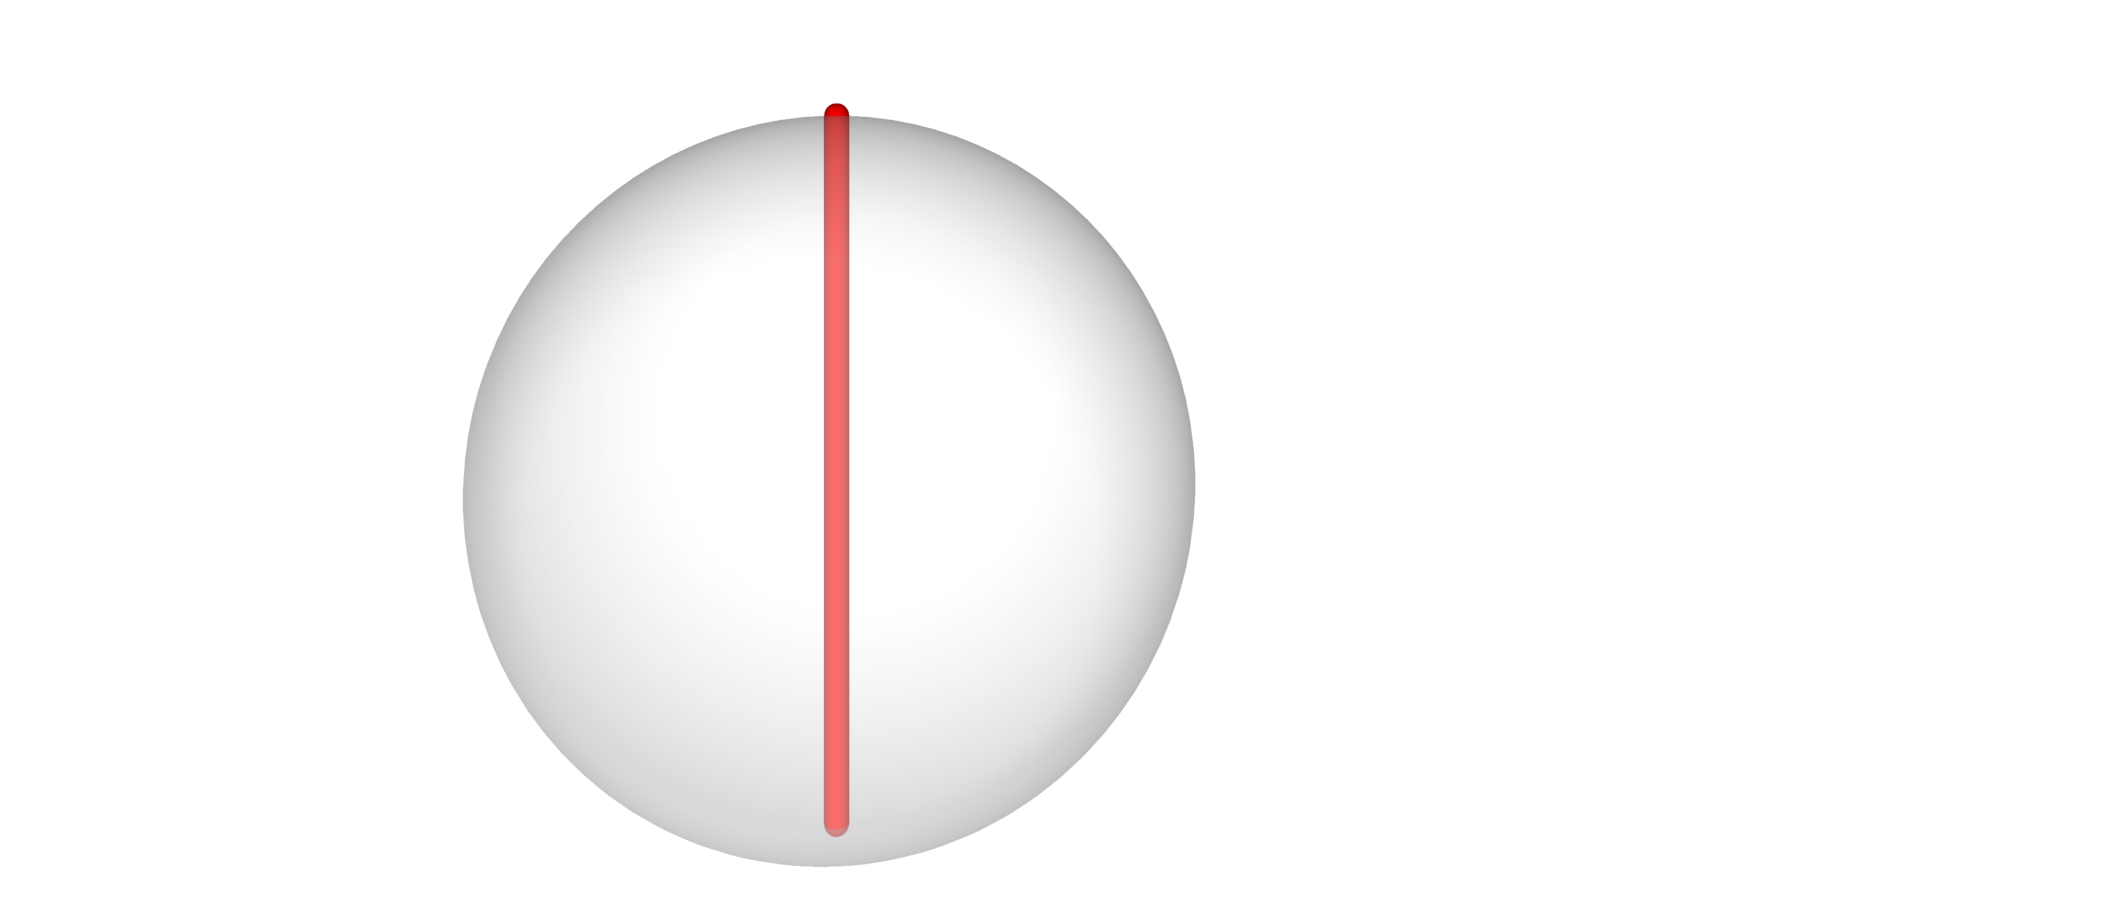
Quantum random access codes

Slide 11
Quantum random access codes

Slide 12
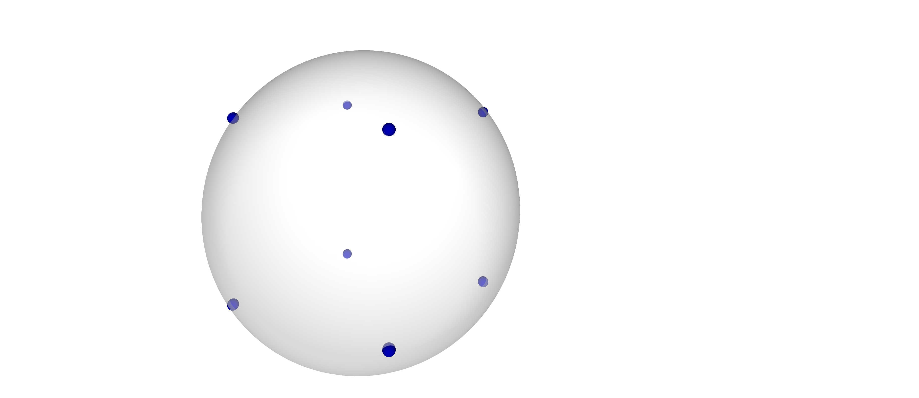
Quantum random access codes

Slide 13
Quantum random access codes

Slide 14
Quantum random access codes

Slide 15
Quantum random access codes

Slide 16
Quantum random access codes

Slide 17
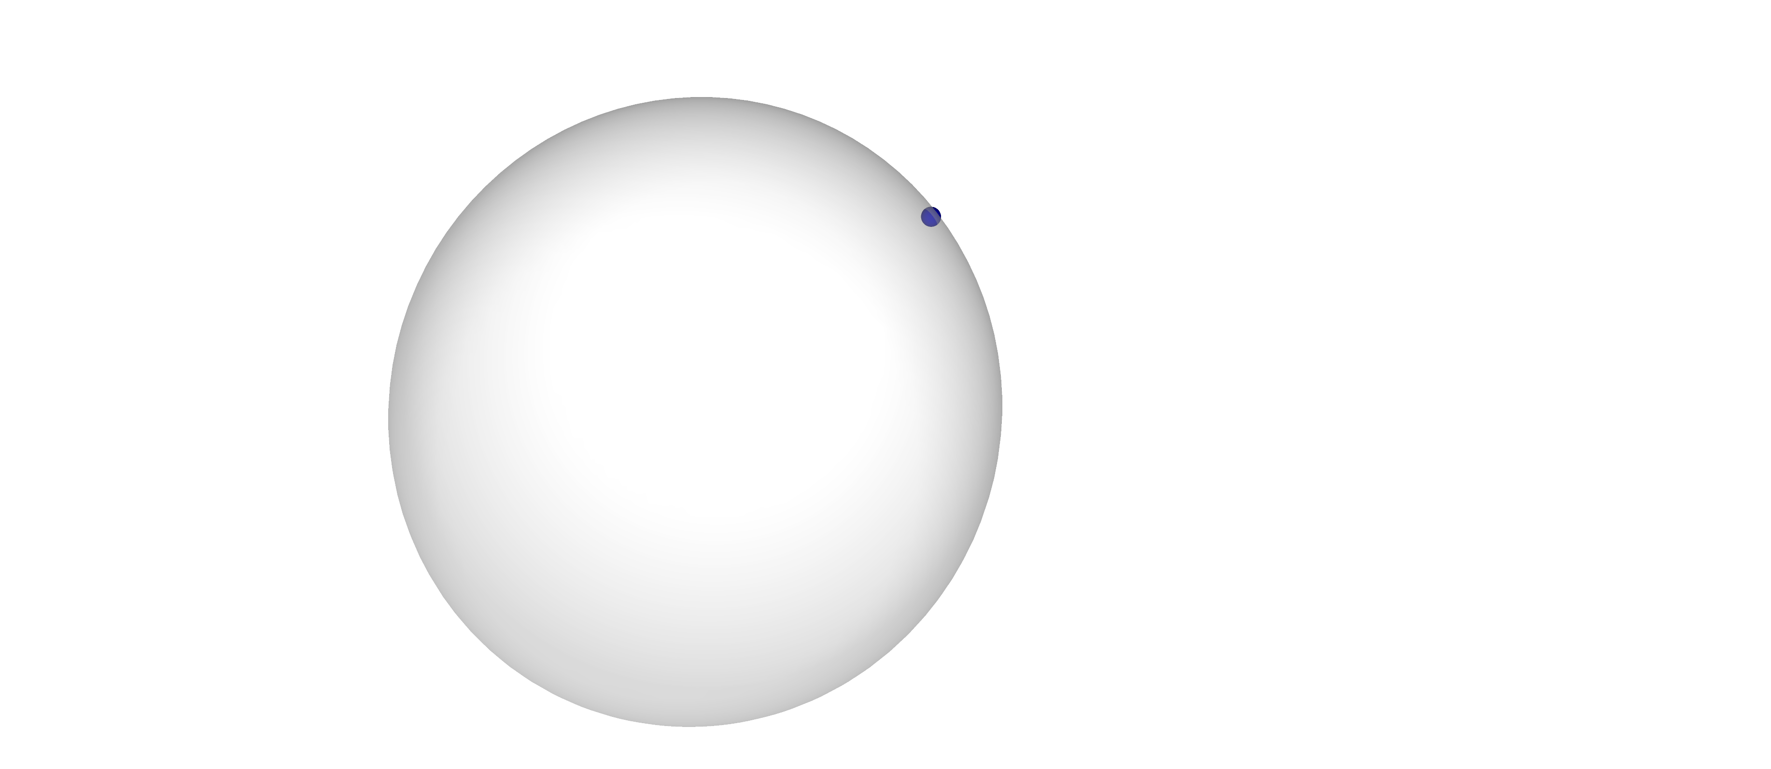
Quantum random access codes

Slide 18
Quantum random access codes

Slide 19
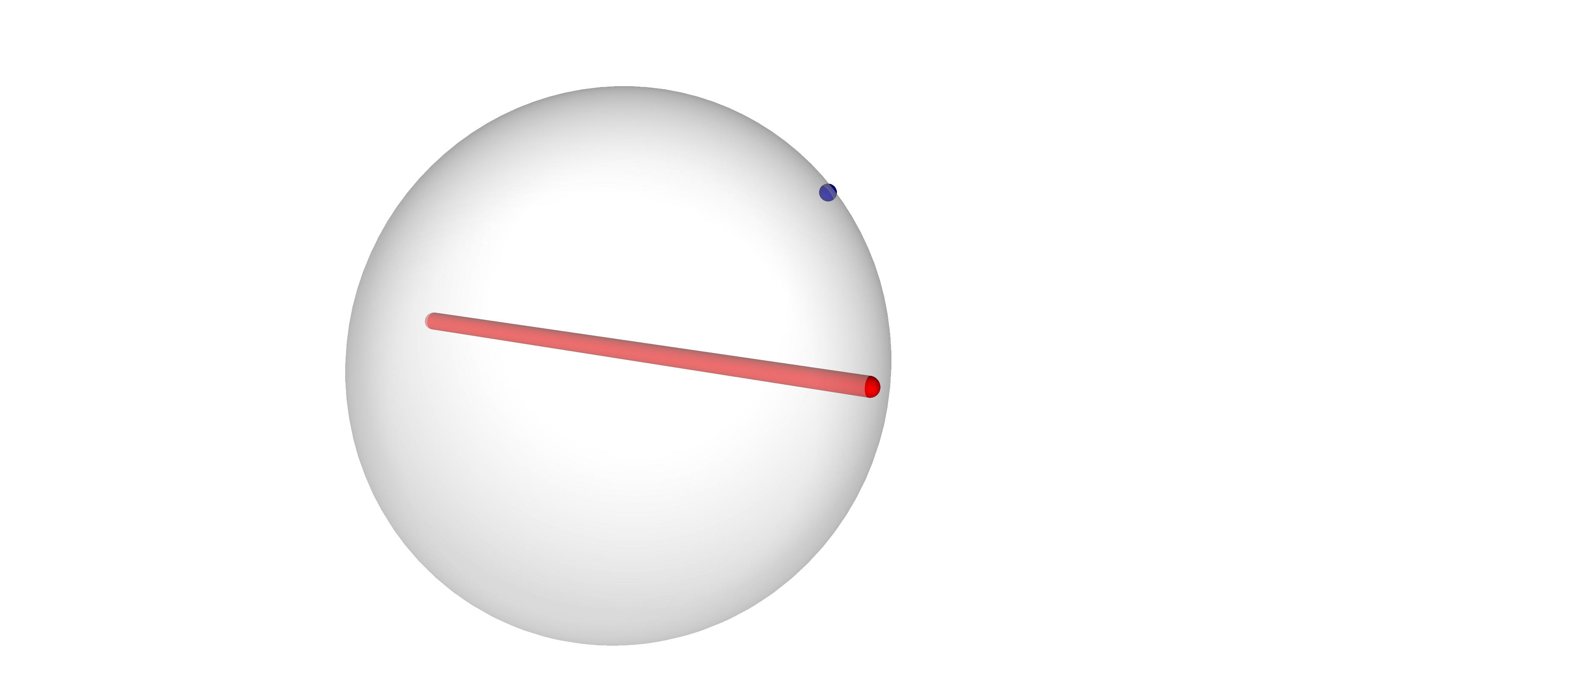
Quantum random access codes

Slide 20
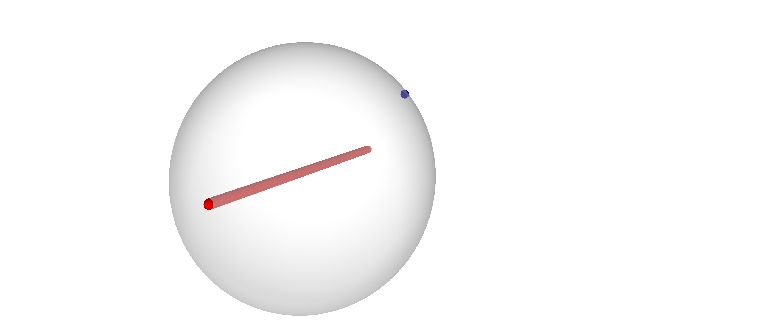
Quantum random access codes

Slide 21
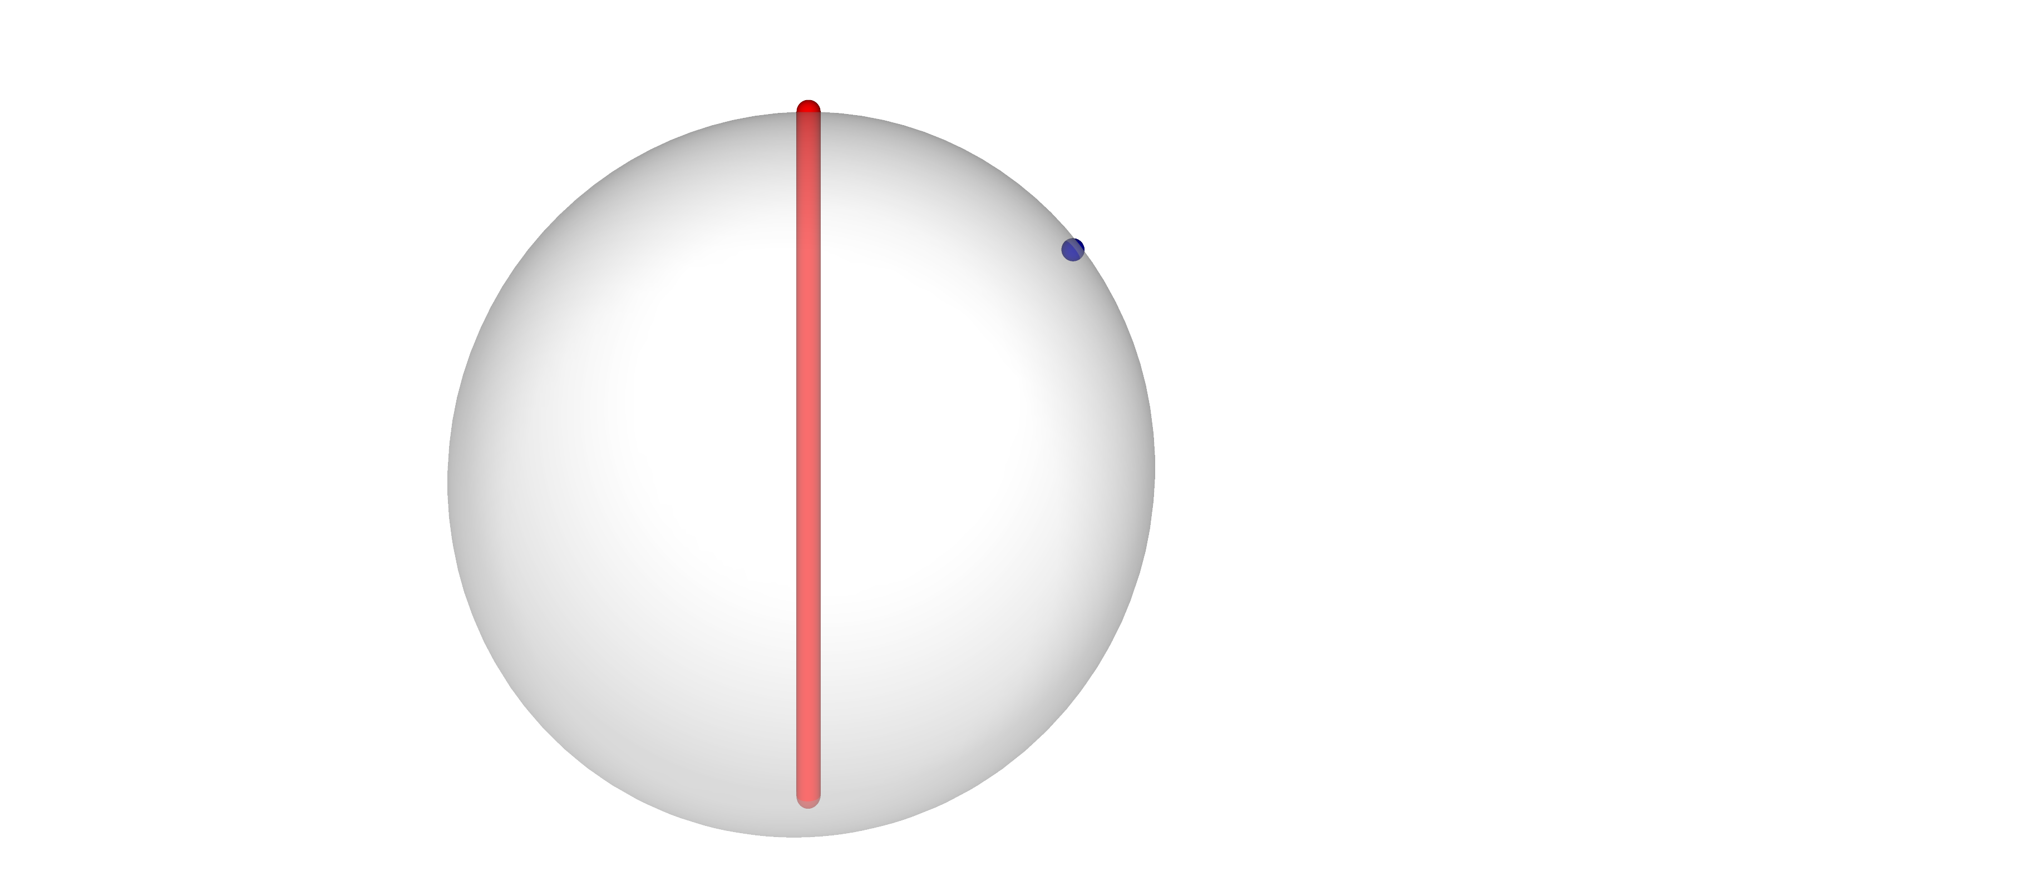
Quantum random access codes

Slide 22
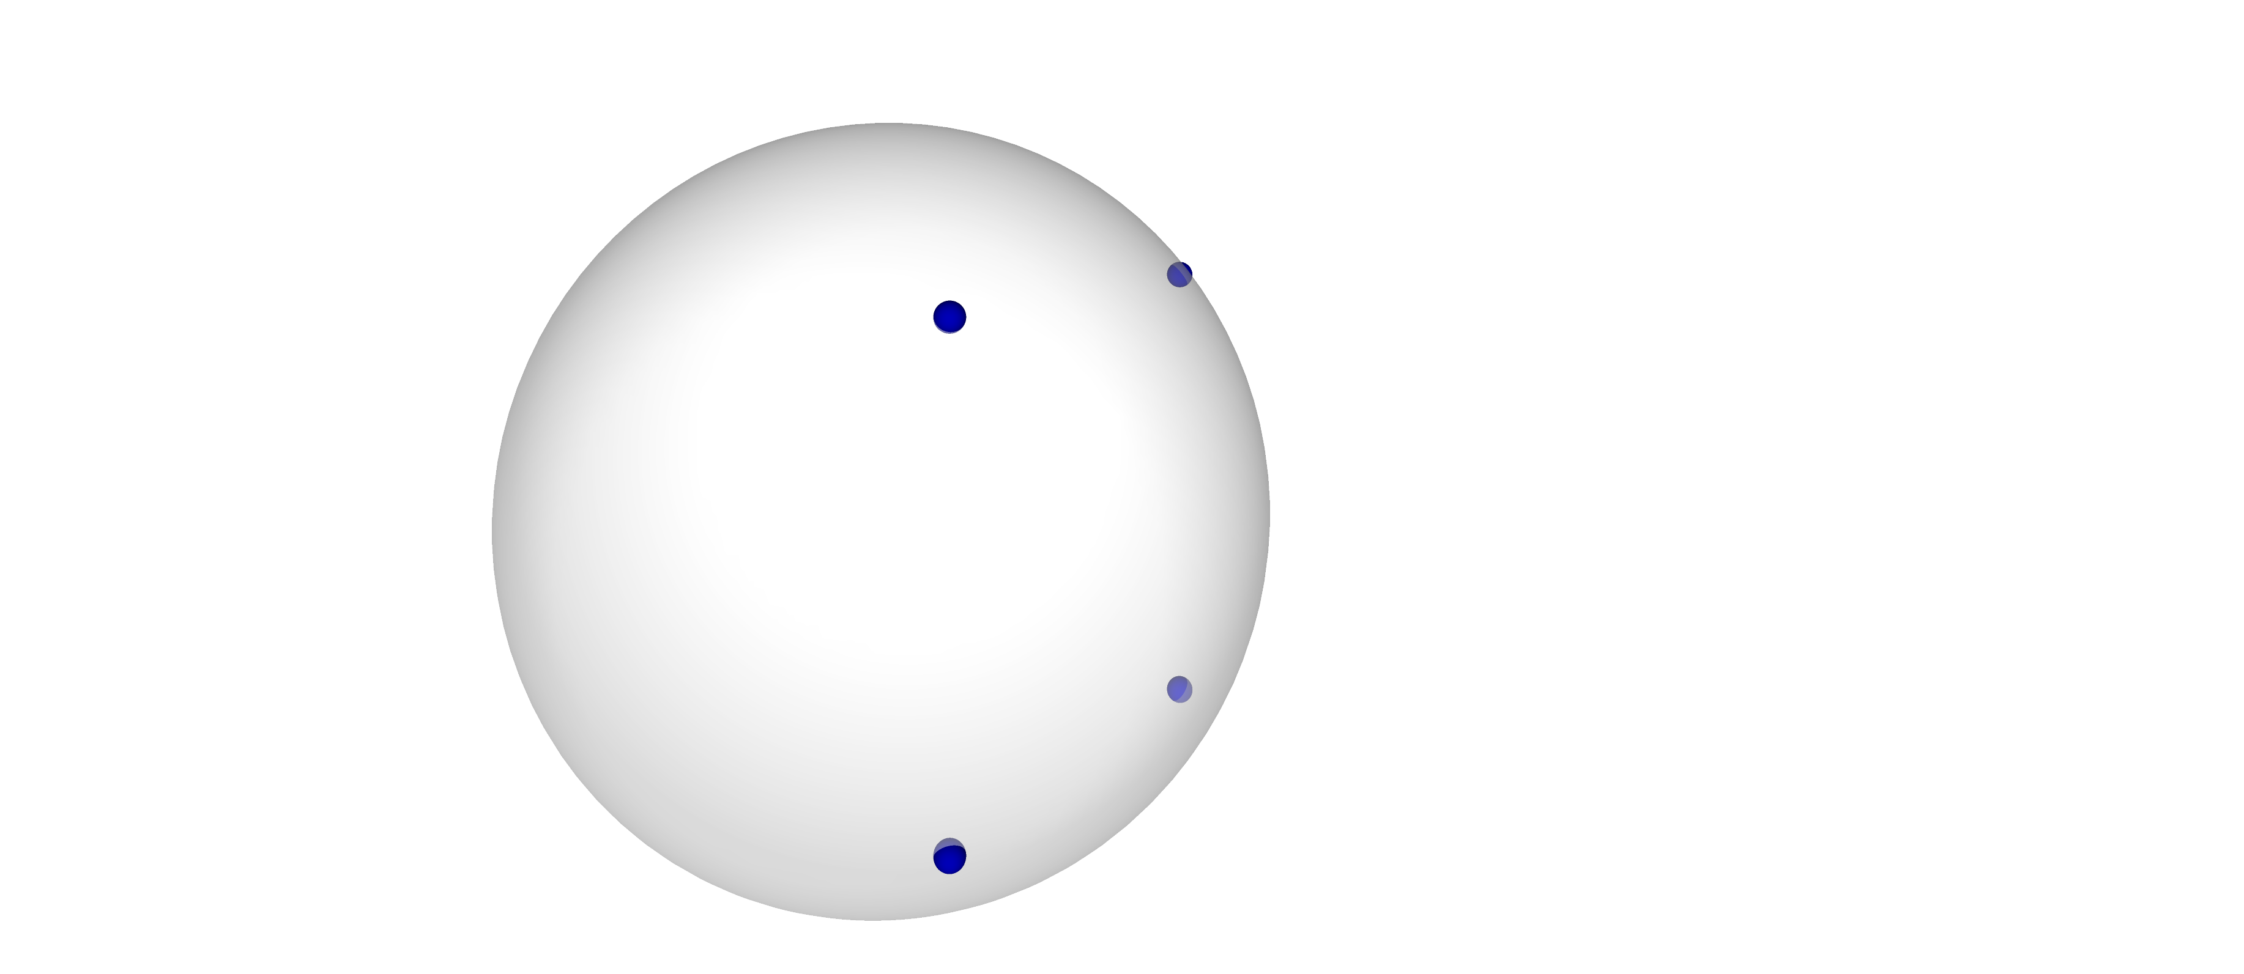
Quantum random access codes

Slide 23
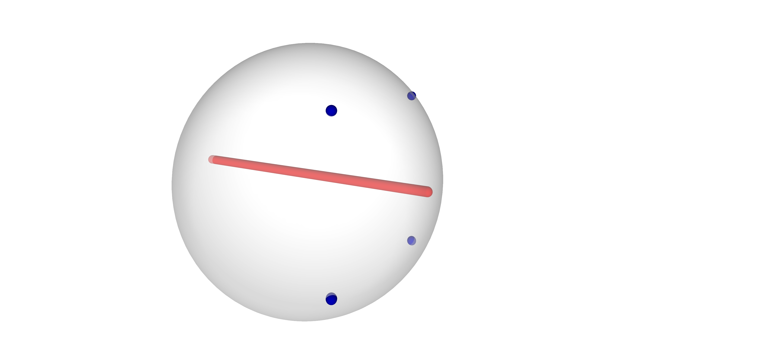
Quantum random access codes

Slide 24
Quantum random access codes
QRACs are good: more variables per qubit
QRACs are bad: each variable’s value is recovered probabilistically

Slide 25
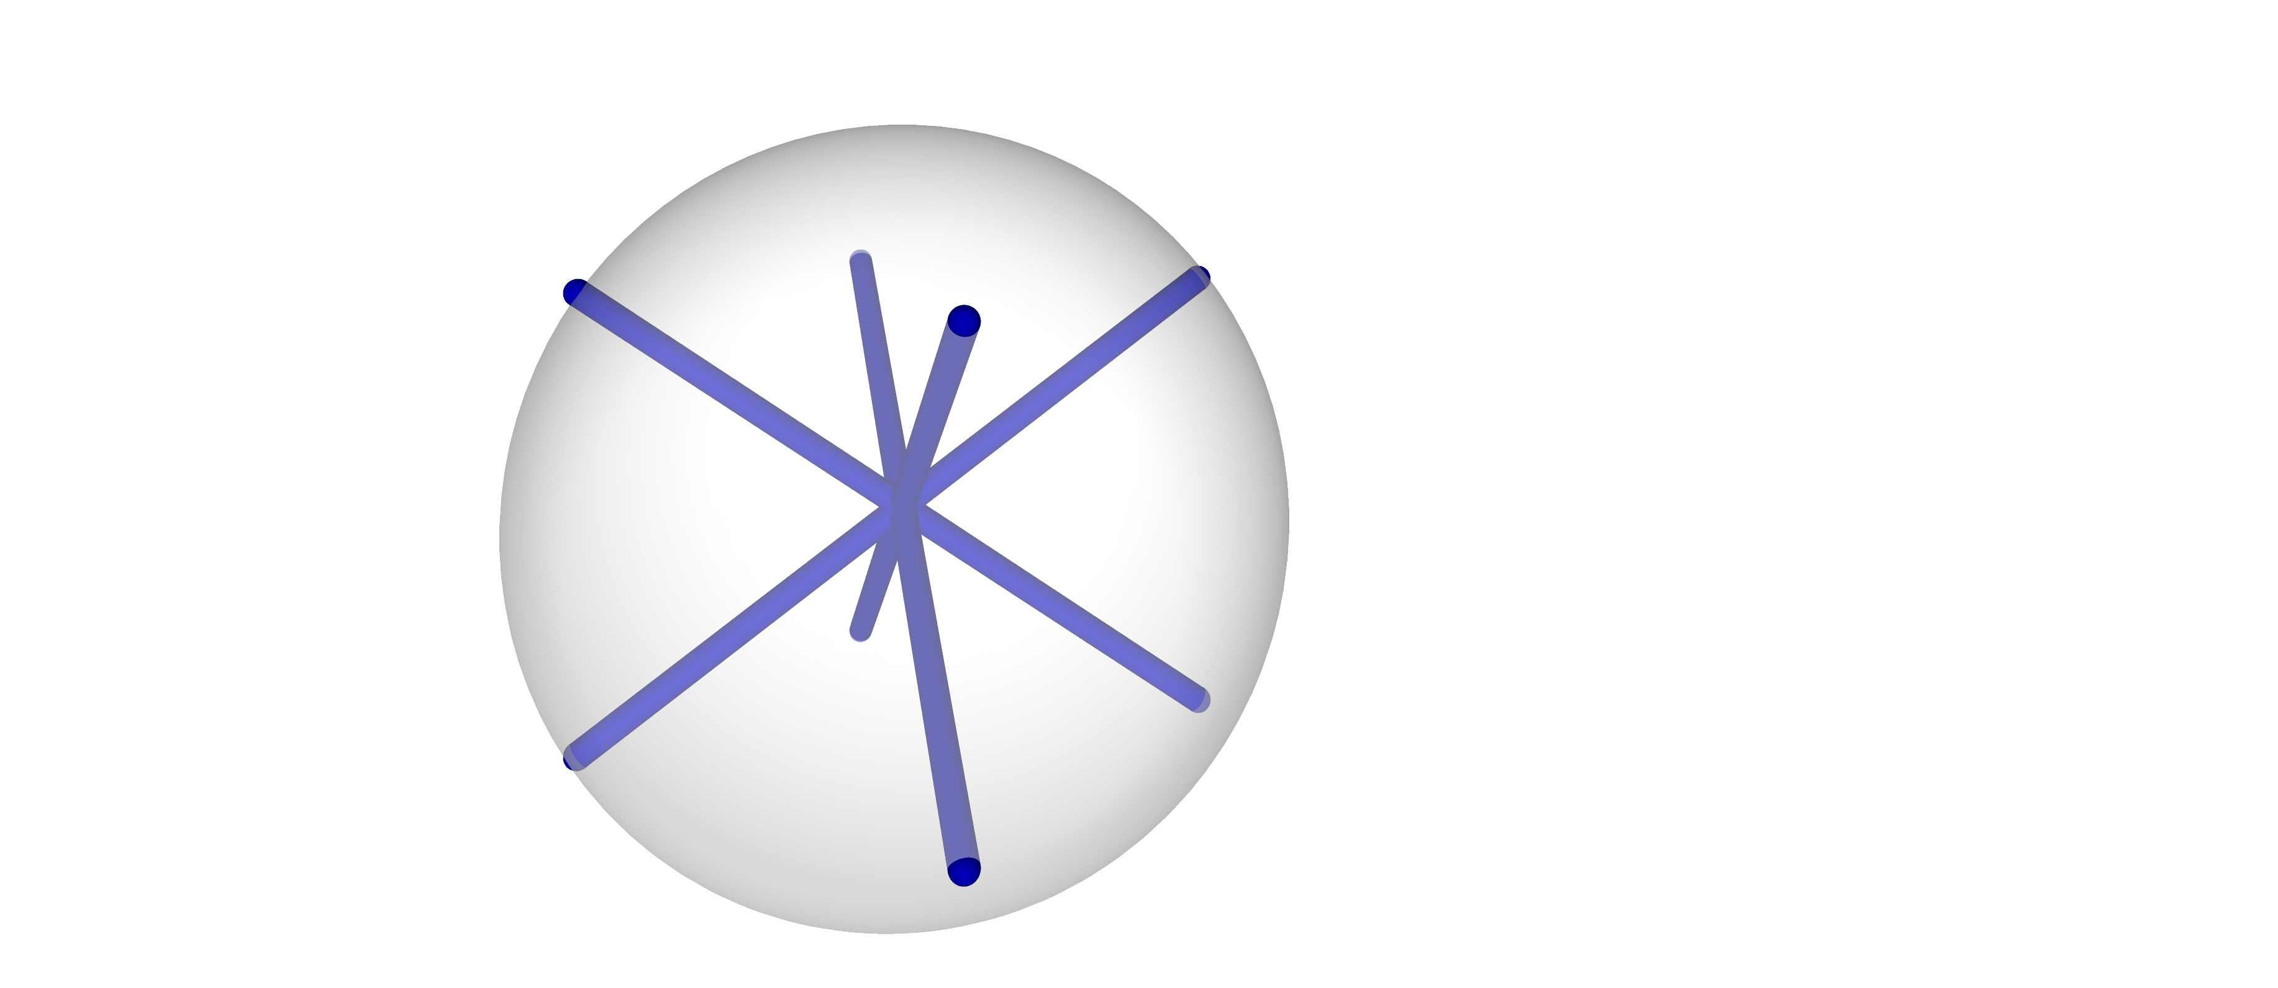
Magic bases

Slide 26

Magic bases

Slide 27
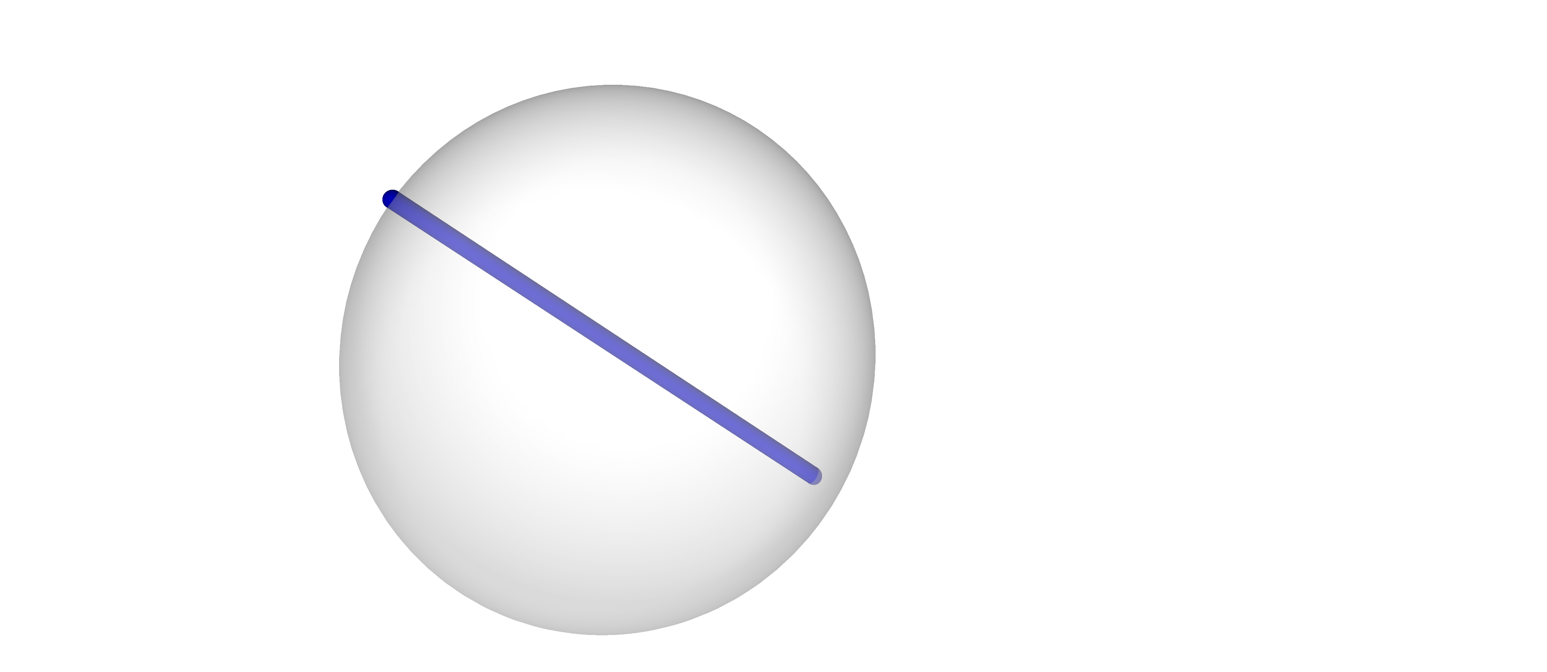
Magic bases

Slide 28
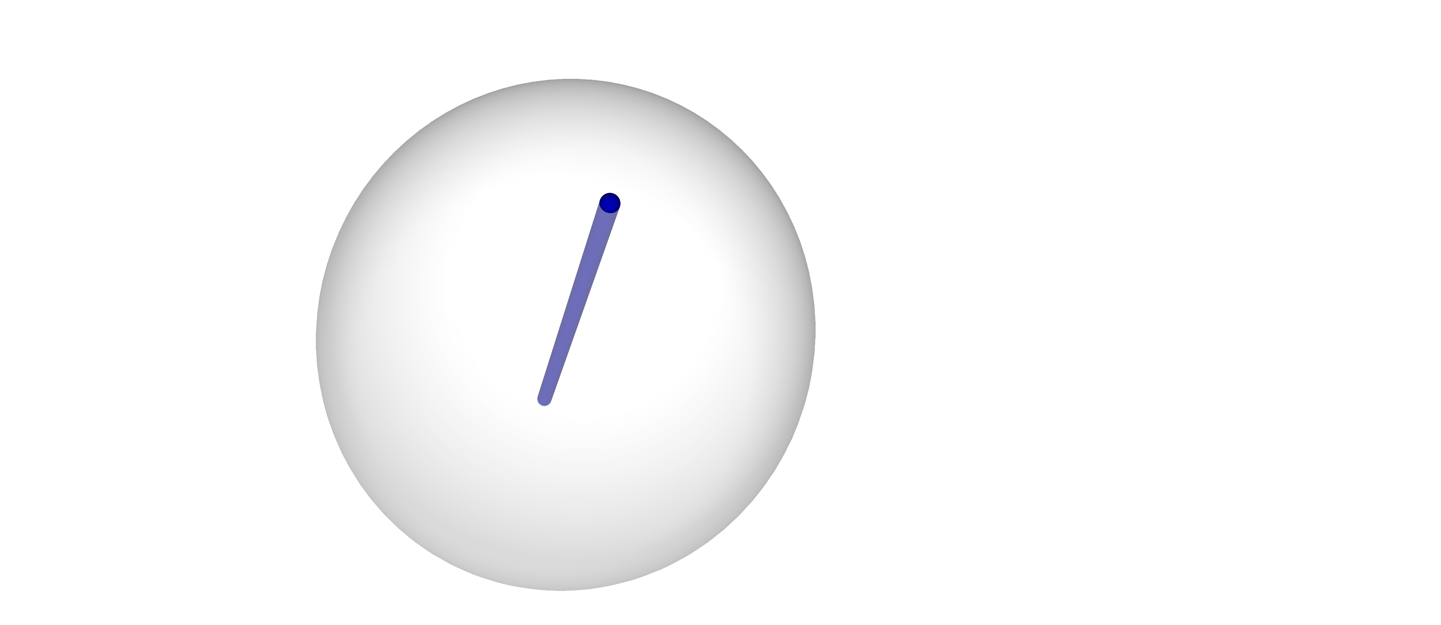
Magic bases

Slide 29
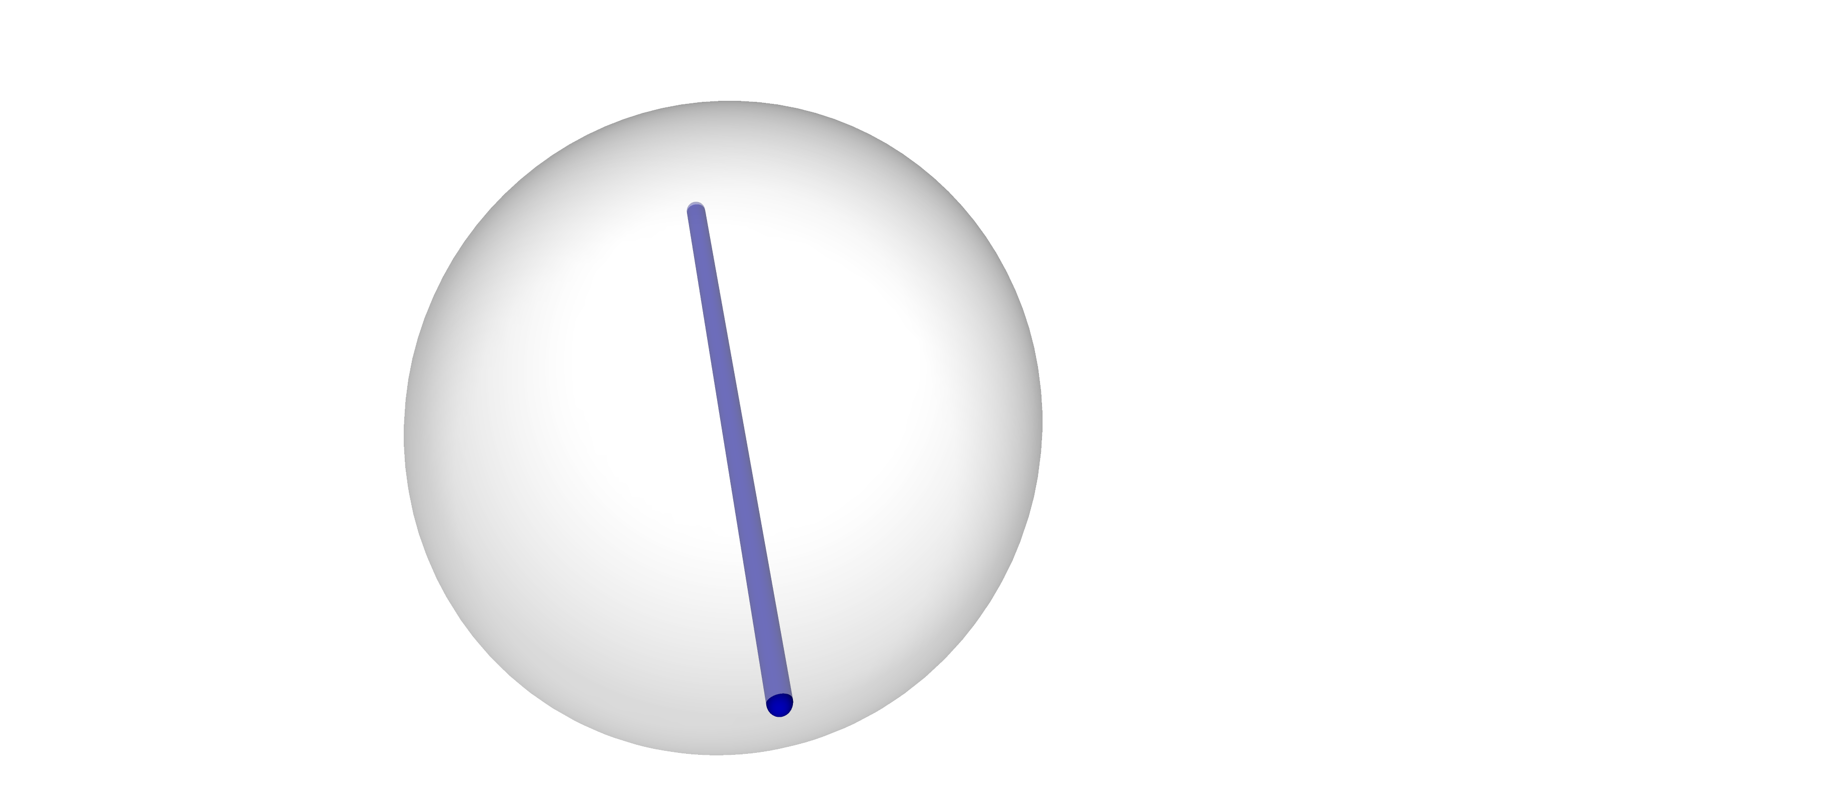
Magic bases

Slide 30
MaxCut
Graph
Binary variables
MaxCut function

Slide 31
MaxCut
Graph
Binary variables
MaxCut function

Slide 32
MaxCut relaxation
Graph
Binary variables
MaxCut function
QRAC encoding
triplets of variables are assigned to one qubit

Slide 33
MaxCut relaxation
Graph
Binary variables
MaxCut function
QRAC encoding
triplets of variables are assigned to one qubit

Slide 34
MaxCut relaxation
Graph
Binary variables
MaxCut function
QRAC encoding
Expectation w.r.t. Hamiltonian

Slide 35
MaxCut relaxation
QRAC allows us to recover binary variables by measuring Pauli operators
MaxCut requires us understanding parities of binary variables whenever an edge is present
Want
Sufficient to make sure vertices of an edge are associated with different qubits
QRAC encoding
Expectation w.r.t. Hamiltonian

Slide 36
MaxCut relaxation
QRAC allows us to recover binary variables by measuring Pauli operators
MaxCut requires us understanding parities of binary variables whenever an edge is present
Want
Sufficient to make sure vertices of an edge are associated with different qubits
QRAC encoding
Expectation w.r.t. Hamiltonian

Slide 37
MaxCut relaxation
QRAC allows us to recover binary variables by measuring Pauli operators
MaxCut requires us understanding parities of binary variables whenever an edge is present
Want
Sufficient to make sure vertices of an edge are associated with different qubits
QRAC encoding
Expectation w.r.t. Hamiltonian

Slide 38
MaxCut relaxation
QRAC allows us to recover binary variables by measuring Pauli operators
MaxCut requires us understanding parities of binary variables whenever an edge is present
Want
Sufficient to make sure vertices of an edge are associated with different qubits
QRAC encoding
Expectation w.r.t. Hamiltonian

Slide 39
MaxCut relaxation
QRAC allows us to recover binary variables by measuring Pauli operators
MaxCut requires us understanding parities of binary variables whenever an edge is present
Want
Sufficient to make sure vertices of an edge are associated with different qubits
Solution: perform graph coloring algorithm first (for example, largest-degree-first heuristic)
QRAC encoding
Expectation w.r.t. Hamiltonian

Slide 40
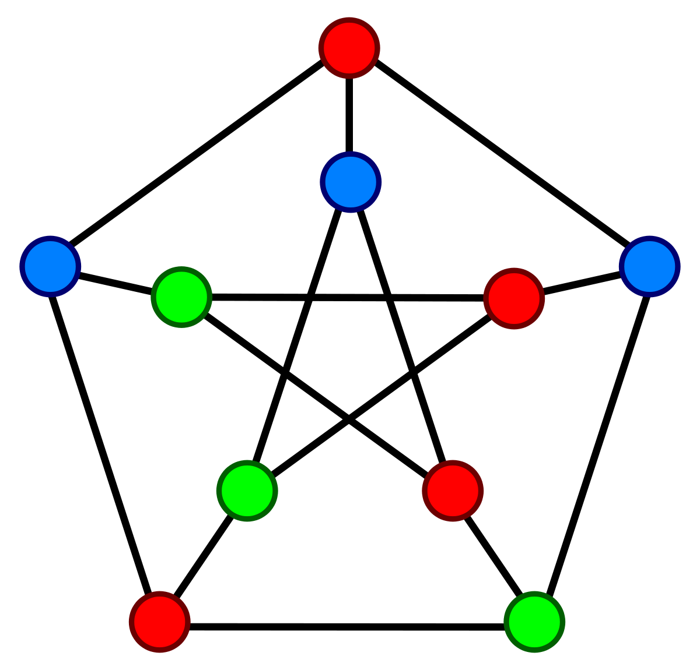
MaxCut relaxation
QRAC encoding
Expectation w.r.t. Hamiltonian

Slide 41
MaxCut relaxation
QRAC encoding
Expectation w.r.t. Hamiltonian

Slide 42
MaxCut relaxation
QRAC encoding
three vertices
three vertices
Expectation w.r.t. Hamiltonian
four vertices

Slide 43
MaxCut relaxation
QRAC encoding
weight 2
Expectation w.r.t. Hamiltonian

Slide 44
( hard ! )
Don’t solve discrete problem
Solve relaxed problem on quantum computer
( hard ? )

Slide 45
VQE in order to find maximum-energy state

Slide 46
VQE in order to find maximum-energy state

Slide 47
VQE in order to find maximum-energy state
Estimator: Classical shadows (Huang, Kueng, Preskill)

Slide 48
VQE in order to find maximum-energy state

Slide 49
VQE in order to find maximum-energy state
Estimator: Classical shadows (Huang, Kueng, Preskill)
Proof: Hoeffding’s inequality, union bound, triangle inequality
even better with locally-biased classical shadows

Slide 50
Rounding
Rounding procedure to obtain admissible state
Energy scale given by trace of Hamiltonian

Slide 51
Rounding via magic bases measurements
Entangled state on qubits
Binary string output

Slide 52
Rounding procedure introduces randomness
Measurement using magic bases
Energy scale given by trace of Hamiltonian

Slide 53
How effective is this rounding procedure?
Energy scale given by trace of Hamiltonian

Slide 54
How effective is this rounding procedure?
Energy scale given by trace of Hamiltonian

Slide 55
How effective is this rounding procedure?
Energy scale given by trace of Hamiltonian

Slide 56
How effective is this rounding procedure?
Energy scale given by trace of Hamiltonian

Slide 57
How effective is this rounding procedure?
Energy scale given by trace of Hamiltonian

Slide 58
How effective is this rounding procedure?
Lieb’s theorem
Energy scale given by trace of Hamiltonian

Slide 59
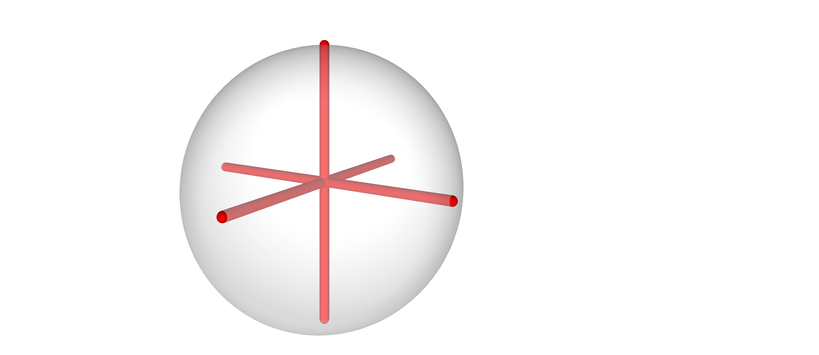
How effective is this rounding procedure?
Proof: Lieb’s theorem (1973) Alternative proof of theorem (2018) by Bravyi, Gosset, König, Temme Observation: Pauli bases and Magic bases are both 2-designs
+ a little algebra

Slide 60
Numerical Simulations
Charles Hadfield, Takashi Imamichi, Toshinari Itoko, Antonio Mezzacapo, Rudy Raymond

Slide 61
Numerical simulations
For an individual graph instance we are quantitatively interested in various values
CPLEX solution to MaxCut
Solution to relaxed problem

Slide 62
Numerical simulations
For an individual graph instance we are quantitatively interested in various values
Average ratio of rounded relaxed solution to CPLEX
3.
2.
1.
CPLEX solution to MaxCut
Average value of rounded relaxed solution
Solutions to relaxed problem using: 1. Exact diagonalization 2. VQE with entanglers 3. VQE without entanglers

Slide 63
Was that the only algorithm?
Charles Hadfield, Takashi Imamichi, Toshinari Itoko, Antonio Mezzacapo, Rudy Raymond

Slide 64
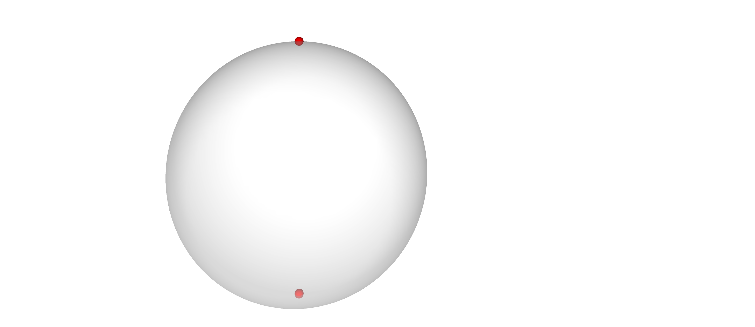
Deformations

Slide 65
Deformations

Slide 66
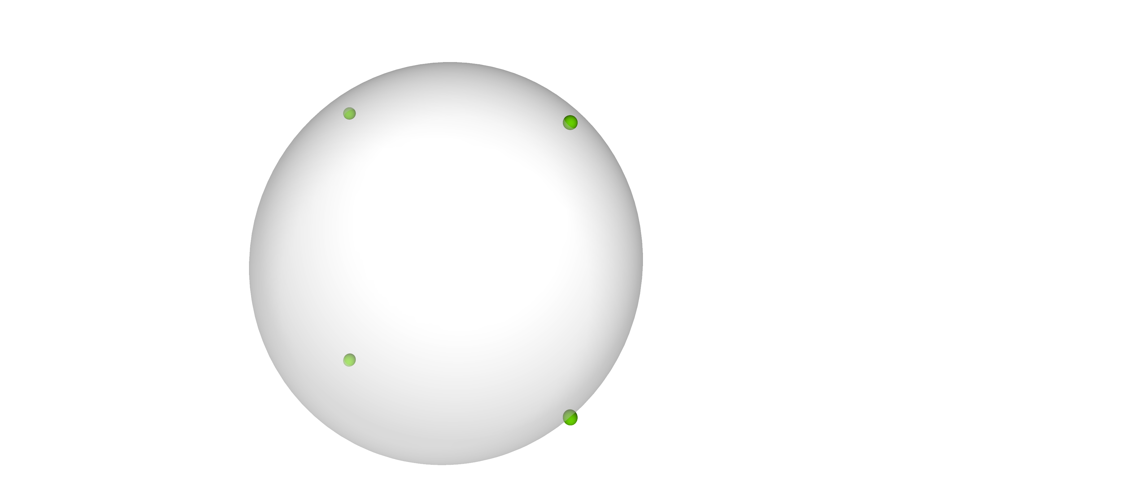

Deformations

Slide 67
Deformations

Slide 68
Deformations
consider a graph whose vertices are partitioned

Slide 69
Deformations
consider a graph whose vertices are partitioned
use QRAC to embed and create 2-local Hamiltonian

Slide 70
Deformations
consider a graph whose vertices are partitioned
use QRAC to embed and create 2-local Hamiltonian
find maximum-energy eigenstate using VQE

Slide 71
Deformations
consider a graph whose vertices are partitioned
use QRAC to embed and create 2-local Hamiltonian
find maximum-energy eigenstate using VQE
quantum round

